Slide 1
Introduction to univariate AR state-space models
Eli Holmes
FISH 507 – Applied Time Series Analysis
21 January 2019

Slide 2
Points from Thursday
Data affected by a perturbation is problematic for arima(), Arima().
Seasonal ARIMA has effect of Jan (or Feb …) in year t on Jan (or Feb …) in year t+1. Not typical when working with population data.
Removing the mean season is different than a seasonal difference.
Data with multiple seasons (daily, monthly, yearly) will be problematic for standard ARIMA seasonal models.
Linear effects of past values might be problematic.

Slide 3
Weeks 1-3.5: building blocks for analysis of multivariate time-series data with observation error, structure, and missing values
Matrix math (multivariate)
Properties of time series data
AR and MA models
State-space models: observation + process model
Model evaluation and model selection
Fitting models with STAN (non-linear, non-Gaussian, disparate data streams)
Starting next week: we will put this all together to start analyzing ecological data sets

Slide 4
univariate linear state-space model
The x model is the classic “random walk”. This model is a random walk observed with error.

Slide 5
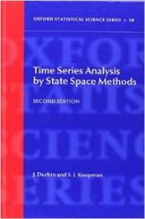
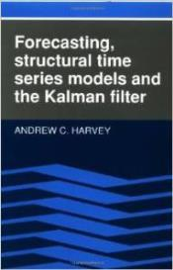
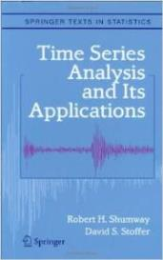
univariate linear state-space model
Many textbooks on this class of model. Used in extensively in economics and engineering

Slide 6
Definition: AR-1 or AR lag-1
Value at time t is the value at time t-1 plus random error

Slide 7
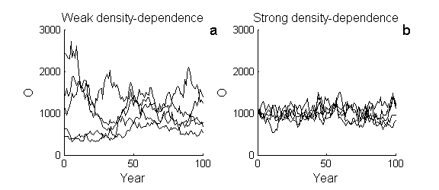
Addition of “b” (<1) leads to process model with mean-reversion,
Log-space
b<1: Gompertz density-dependent process

Slide 8
This model is quite hard to fit
Log-space
b and u are confounded = ridge likelihood = many b/u combinations that fit the data
If you have observation error, you need either long times or replication to estimate this model.

Slide 9
Why is the AR-1 model so important in analysis of ecological data?
Additive random walks
Movement, changes in gene frequency, somatic growth if growth is by fixed amounts
Why normal? The average of many small perturbations, regardless of their distribution, is normal
Multiplicative random walks
Population growth, somatic growth if growth is by percentage
take log and you get the linear additive model above. log-normal means that 10% increase is as likely as 10% decrease

Slide 10
An AR-1 random walk can show a wide-range of trajectories, even for the same parameter values
All trajectories came from the same rw model: x_{t}= x_{t-1} -0.02+e_{t}, e_{t} ~ Normal(mean=0.0, var=0.01)
same as the “stochastic exponential growth model”: N_{t}= N_{t-1} exp(-0.02+e_{t})

Slide 11
Definition: state-space
The “state”, the x, is a hidden (dynamical) variable. In this class, it is a hidden random walk.
Our data, y, are observations of this.
Often state-space models include inputs (explanatory variables). and typically at least the x is multivariate, and often also y.
The model you are seeing today is a simple univariate state-space model with no inputs.
state process
obs process

Slide 12
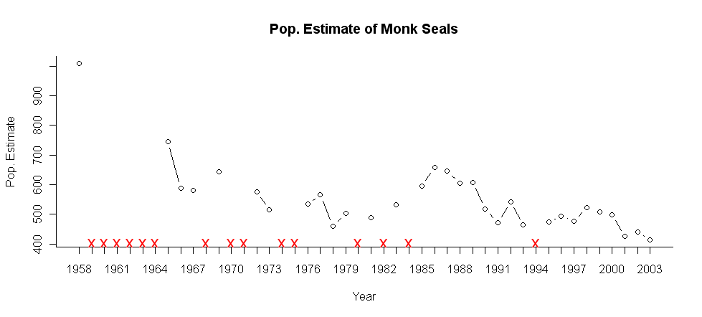
univariate example: population count data
Yearly (usually) population (or subpopulation) counts
Missing values

Slide 13
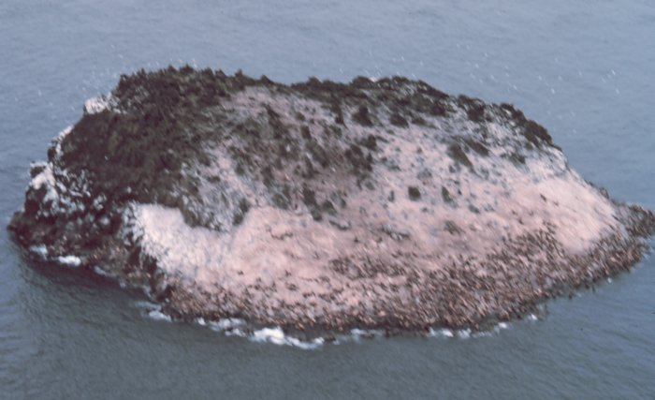
Observation error
There IS some number of sea lions in our population in year x, but we don’t know that number precisely. It is “hidden”.

Slide 14
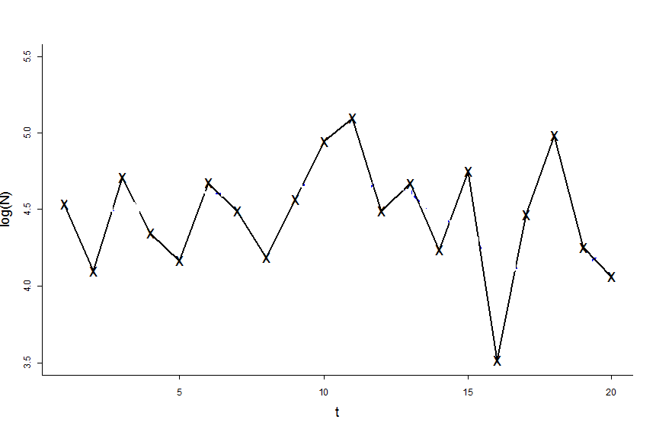
Suppose we have the following data
(population counts logged)

Slide 15
A linear regression model
What about fitting a regression line through the data?
state
Regression is fitting a deterministic process through the data
no “process” variability
all variability = “non-process or observation error”

Slide 16
Versus a state-space model
Autoregressive state-space models fit a RANDOM WALK through the data
variability = “observation error” + “process error”
state

Slide 17
Two types of variability
#1 observation or “non-process” variability
Observation
Process or state
Difference between observation and process is the non-process error

Slide 18
Two types of variability
#1 observation or “non-process” variability
The non-process (observation) variance is often unknowable in fisheries and ecological data
Sightability varies due to factors that may not be fully understood or measureable
Environmental factors (tides, temperature, etc.)
Population factors (age structure, sex ratio, etc.)
Species interactions (prey distribution, prey density, predator distribution or density, etc.)
Sampling variability--due to how you actually count animals--is just one component of observation variance

Slide 19
#2 Process variability
This the process line. It ‘wiggles’ due to process variability. The next few lectures we will focus on processes that are simple random walks with drift:

Slide 20
Process error is the difference between the expected x(t) and the actual value
Let’s say that in x(t)=x(t-1)-0.02+e(t)*
The difference between “x”, the expected value, and the blue square, actual value, is the process error
“x” shows the expected x(t) at time t; it is like the prediction from a deterministic process
*If this were a population model, that means a the mean rate of decline is ca 2% per year
Notes:
Label axes; add points to blue line; previous slide; t to t+4

Slide 21
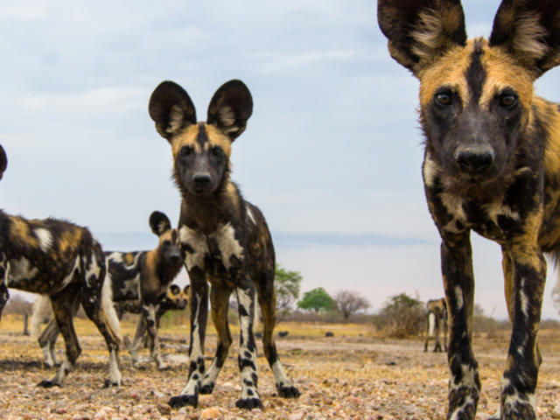

Slide 22
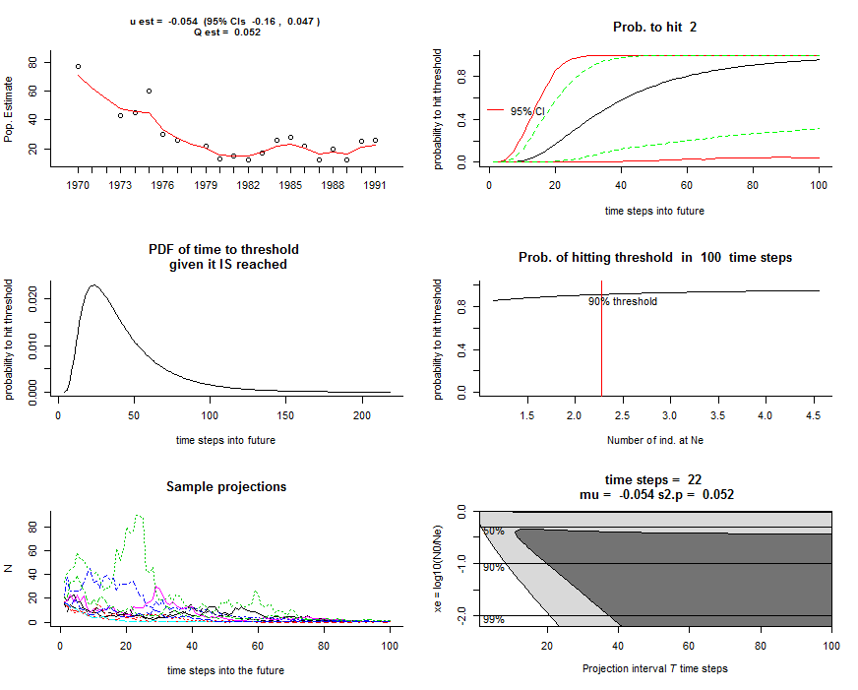
One use of univariate state-space models is “count-based” population viability analysis (chap 6 HWS2014)

Slide 23
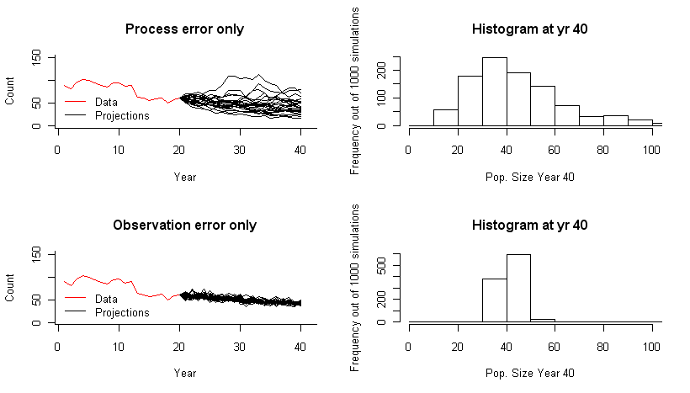
How you model your data has a large impact on your forecasts

Slide 24
How can we separate process and non-process variance?
Wouldn’t these two variances be confounded and impossible to estimate simultaneously?
Notes:
Put this title with plot of meas + process

Slide 25
How can we separate process and observation variance? They have different temporal patterns.
Process error: x_{t} = x_{t-1} + u +e_{t}
multiple sims of x(t) with same u and q
Observation error: y_{t} = x_{t} + η_{t}
multiple sims of y(t) with same x(t)

Slide 26
An AR-1 state-space model combines a model for the hidden AR-1 process with a model for the observation process
…and allows us to separate the variances
Process model
AR lag-1
random walk with drift
normally distributed process errors
Observation model
observation errors
normally distributed process errors

Slide 27
A mathematical algorithm that solves for the ‘optimal’ (least error or maximum-likelihood) x_t given all the data (y) from time 1 to t
Kalman Filter: Estimate the x in a state-space model
Predict: Given an x_0, predict x_1 from your model
Update: Given y_1, update your x_1 estimate
Predict: Given an x_1, predict x_2 from your model
Update: Given y_2, update your x_2 estimate
Predict: Given an x_2, predict x_3 from your model
Update: Given y_3, update your x_3 estimate

Slide 28
Let’s simulate and try fitting some models
Open up R and follow after me
univariate_example_1.R
univariate_example_2.R
univariate_example_3.R

Slide 29
How to write a straight-line as AR-1
##Preliminaries: how to write ##x=intercept+slope*t as a AR-1
x(0)=intercept
x(1)=x(0)+slope #this is x at t=1
x(2)=x[1]+slope
so..
x(t)=x(t-1)+slope+w(t), w(t)~N(0,0)

Slide 30
MARSS R Package
Fits MARSS models (multivariate AR-1 state-space)
General, fits any MARSS model with Gaussian errors
But
Maximum likelihood
Slow. Students working with large data sets have gotten huge speed improvements by coding their models in TMB

Slide 31
MARSS R Package
Fits MARSS models (multivariate AR-1 state-space)
MARSS model syntax
X(t) = B X(t-1) + U + w(t), w(t) ~ N(0, Q)
Y(t) = Z X(t) + A + v(t), v(t) ~ N(0,R)
fit2=MARSS(y,model=mod.list)
y is data; model tells MARSS what the parameters are
The parameters are MATRICES
You write matrices just like they appear in your model on paper
You pass model to MARSS as a list

Slide 32
MARSS model in matrix form

Slide 33
X(t) = B X(t-1) + U + w(t), w(t) ~ N(0, Q)
Y(t) = Z X(t) + A + v(t), v(t) ~ N(0,R)
mod.list=list(
U=matrix(“u"),
x0=matrix(0),
B=matrix(1),
Q=matrix(0.1),
Z=matrix(1),
A=matrix(0),
R=matrix("r"),
tinitx=0)
Let’s say we want to fit this model:

Slide 34
Let’s simulate and try fitting some models
Open up R and follow after me
univariate_example_1.R
univariate_example_2.R
univariate_example_3.R

Slide 35
State-space diagnostics
State-space diagnostics

Slide 36
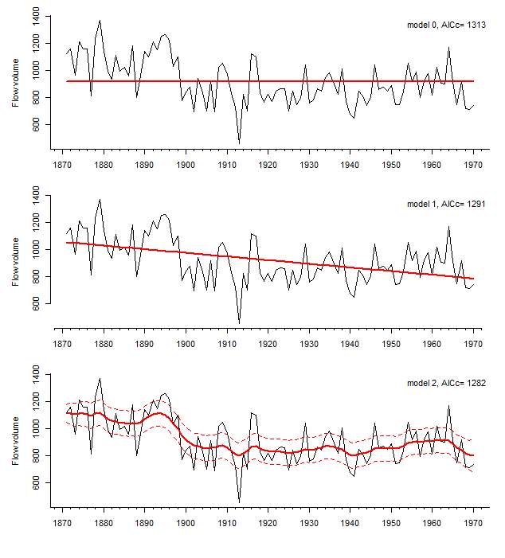
Basic diagnostics
Nile River models from the lab handout

Slide 37
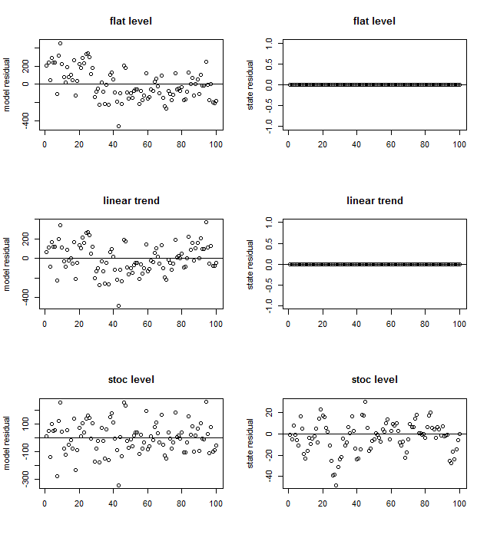
Basic diagnostics: #1 plot the residuals
Model residuals
State residuals
There should be no temporal trends!
They should be centered about 0.

Slide 38
non-process error or model residual
Observation
Process or state
Difference between observation and process is the non-process error also called “model residual”

Slide 39
process error or state residual
Observation
Process or state
Difference between the forecasted state at time t given the state at time t-1 and the actual state at time t

Slide 40
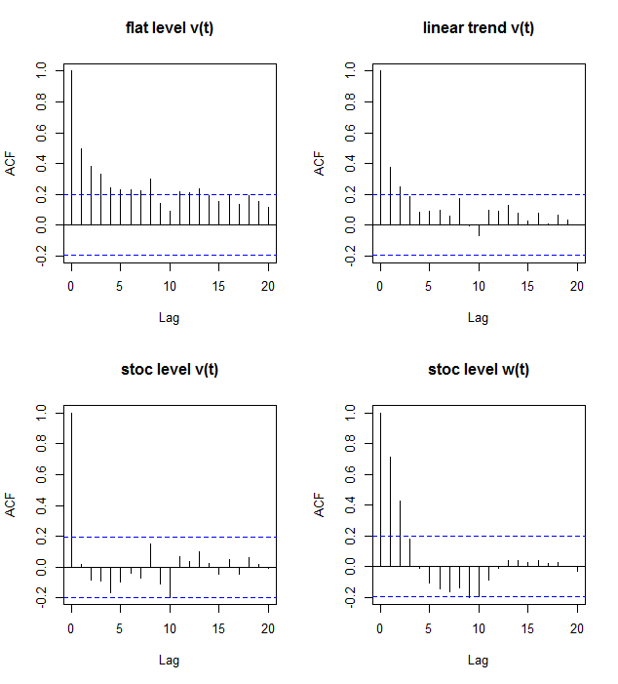
Basic diagnostics: #2 check acf of residuals
v(t) are model residuals
w(t) are state residuals

Slide 41
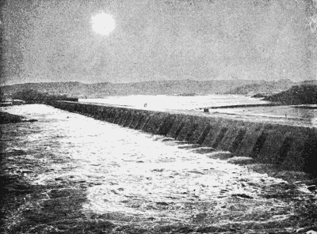
Even our ‘best’ model is missing something...

Slide 42
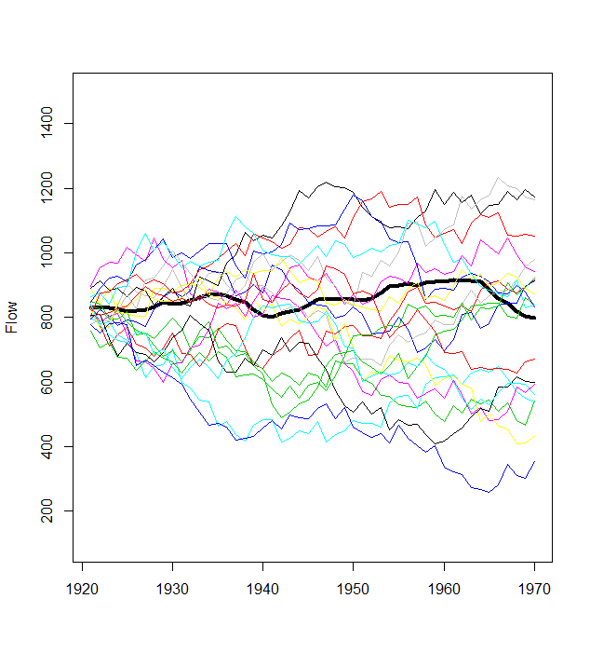
Basic diagnostics: #3 Simulate from your estimated model and compare to the data.
Black line is the estimated state from model 2

Slide 43
Basic diagnostics #4 Simulate from known model and then test whether you can re-capture the true estimates

Slide 44
How do you know when to use a process error or observation error model?
If your time-series data contain both types, use a model with both types.
To estimate both variances, you need a) 20+ time steps OR b) multi-site data.
If you don’t have enough data, you need to use assumptions about one of the variances. Meaning a) fix the value or b) incorporate a prior.
Diagnostics: Observation error induces autocorrelation in the noise of an autoregressive process. Fit a process-error only model (R=0) and check for autocorrelation of residuals

Slide 45
Other types of “non-process” error
Fluctuations that don’t have “feedback” (variance doesn’t explode)
Lots of biological processes also create noise that looks like that
age-structure cycles o cyclic variability in fecundity
density-dependence o predator-prey interactions
If your model cannot accommodate that cycling,
it tends to get ‘soaked’ up in the ‘non-process’ error component
If your model can accommodate that cycling,
estimation of ‘observation error’ variance can be confounded, unless you have long, long datasets or replicates

Slide 46
Thursday lecture: multivariate state-space
Thursday lab: fitting univariate and multivariate state-space models

